Slide 1
ART
Tuesday, 15 DEcember 2015
A Voice Controlled Drone System
Rekayasa Perangkat lunak

Slide 2
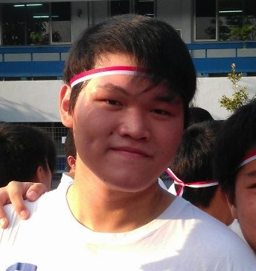

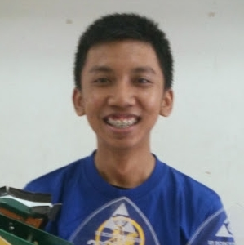
The Team
ART

Slide 3

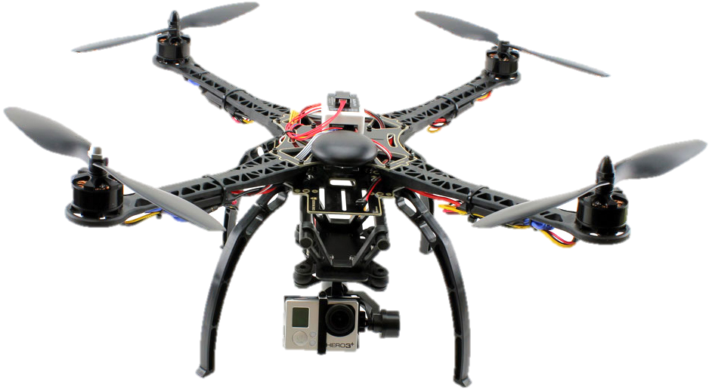

Project Overview
Referensi :
http://droneselect.com/wp-content/uploads/2015/02/51Nk8iyrmLL._SL1000.jpg
http://beingandroid.com/wp-content/uploads/2011/12/android_voice.jpg?584900
http://kanalsatu.com/images/20150514-154646_44.png

Slide 4
Organizational Structure
Main Role | Additional Job | Name | email | Institution
Project Team Member | Hardware Developer | Aldwin Akbar Hermanudin | aldwin.akbar@ui.ac.id | Faculty of Engineering University of Indonesia
Project Team Member | Software Developer | Rudy Nurhadi | rudy.nurhadi@ui.ac.id
Project Team Leader | Software Designer | Tomi | tomi@ui.ac.id

Slide 5
Project Responsibilities
Role | Description | Person
Project Team Leader | Planning and coordinating team activities; Providing feedback about team progress; Motivating Team Member; Chairing reviews of the items made by his team. Additional Job: Software designer | Tomi
Project Team Member | Main Job: Assisting the team leader, Checking Progress, Defining work packages and Goals; Additional Job: Hardware Developer | Aldwin Akbar
Project Team Member | Main Job: Assisting the team leader by signaling problem in an early stage; Additional Job: Software Developer | Rudy Nurhadi

Slide 6
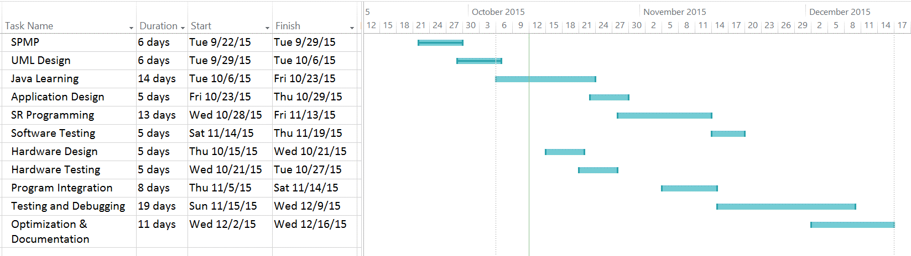
Project Management
To finish our project perfectly, we need a guidance and a software manager to make us keep in line and focus as we run the project. We can make a timeline as our guide-plan. The timeline mentioned before was created using Microsoft Office Project Professional 2016. By using this software, each person can participate building this project with much more efficient and structured.

Slide 7
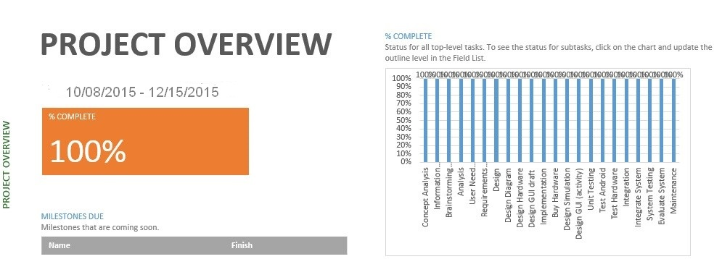
Project Management

Slide 8
Design
Designing is the process in which the team creates a specification of a software artifact, intended to accomplish goals, using a set of primitive components and regarding the constraints. Designing is the step of conceptualizing, planning, and understanding the foundation and process of the projects.
UML Diagram
UML, which stands for Unified Modeling Language, is really important as the pre-process state.

Slide 9
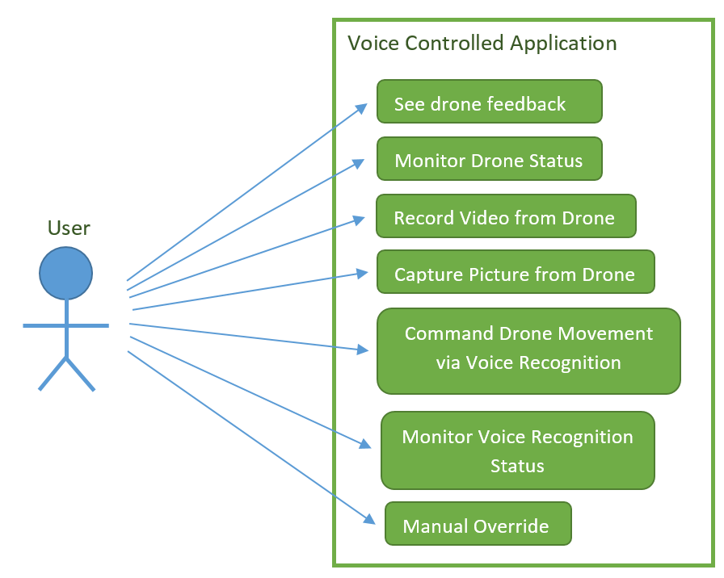
Case Diagram

Slide 10
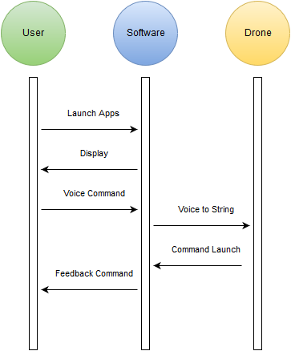
Sequence Diagram

Slide 11
Deployment Diagram

Slide 12
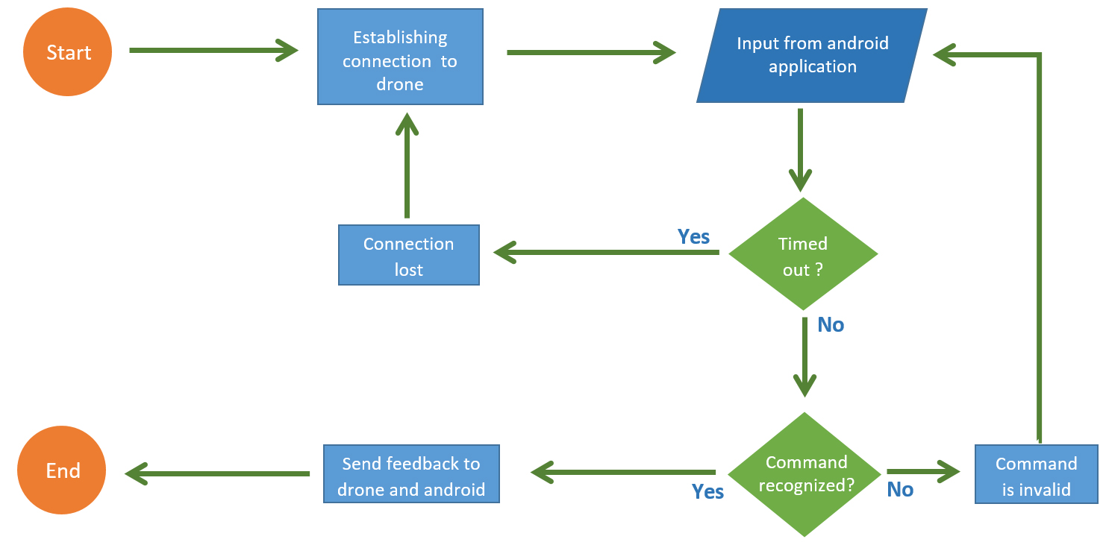
Activity Diagram

Slide 13
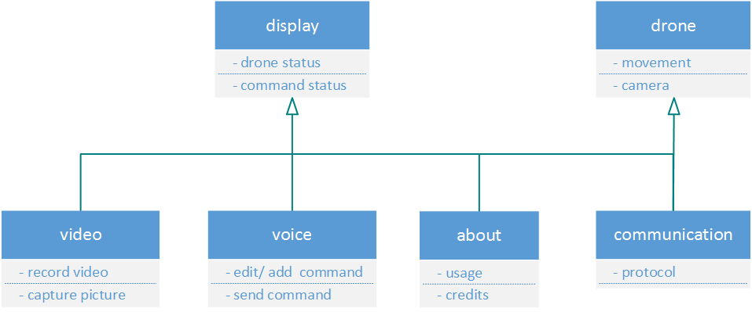
Class Diagram

Slide 14
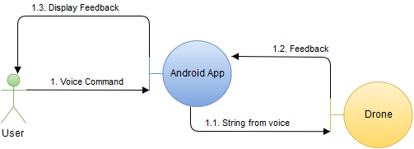
Communication Diagram

Slide 15
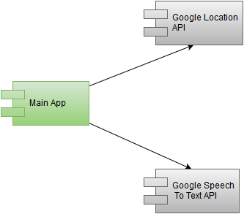
Component Diagram

Slide 16
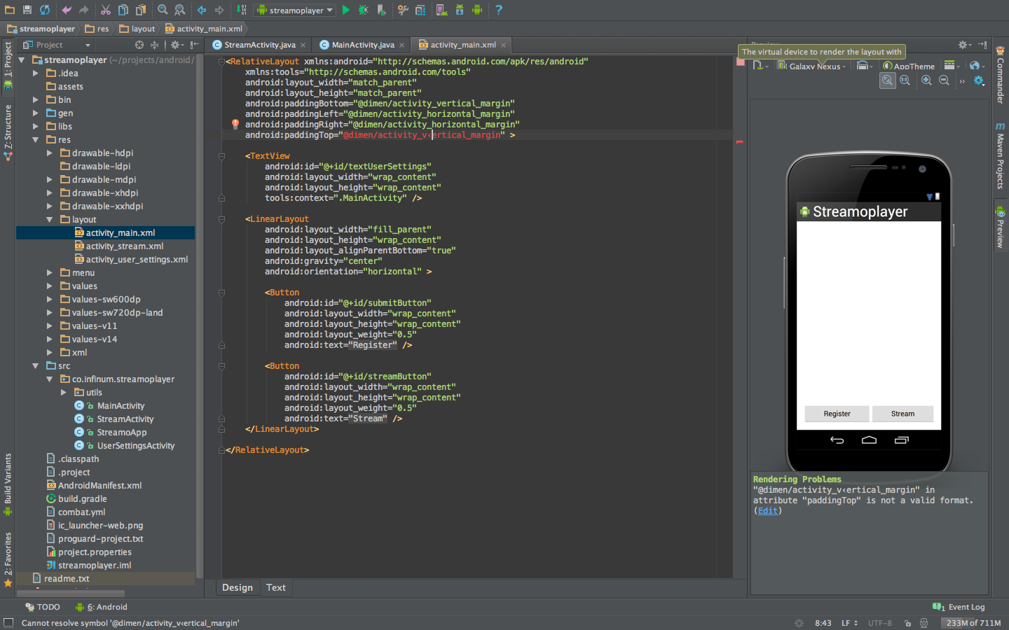
Software Tools
Android Studio
Referensi :
https://s3.amazonaws.com/infinum.web.production/repository_items/files/000/000/168/original/android-studio-3.png?1393599622

Slide 17
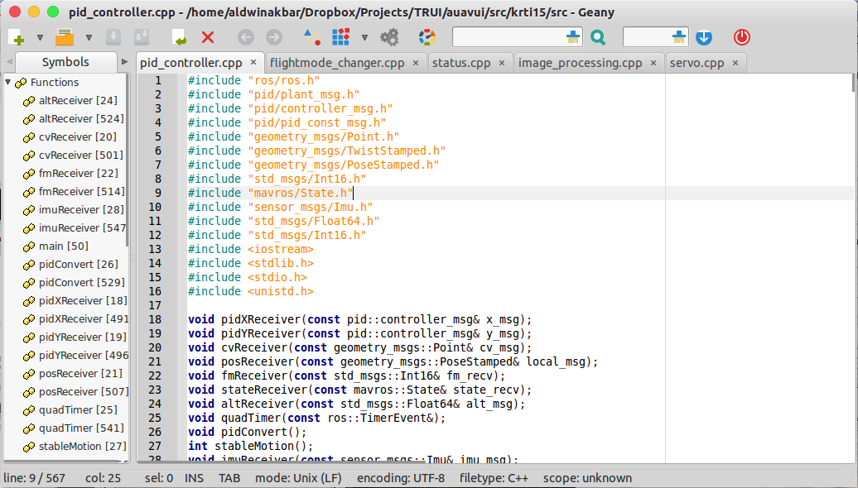
Software Tools
Geany

Slide 18

Software Tools
Robotic OS
Referensi :
http://www.active8robots.com/wp-content/uploads/ros.png

Slide 19
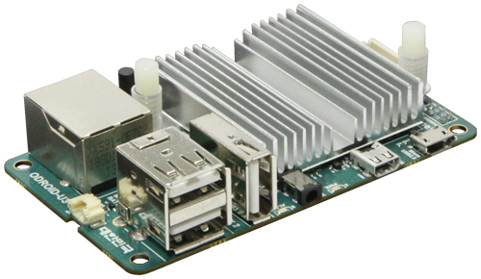
Hardware Tools
Odroid U3
Components | Detail
CPU | 1.7 Ghz QuadCore
Memory | 2GB LPDDR2
DC Input | 5V/ 2A
USB Host | 3 Ports
Storage | uSD and eMMC
Referensi :
http://dn.odroid.com/homebackup/201312222305368236.jpg

Slide 20
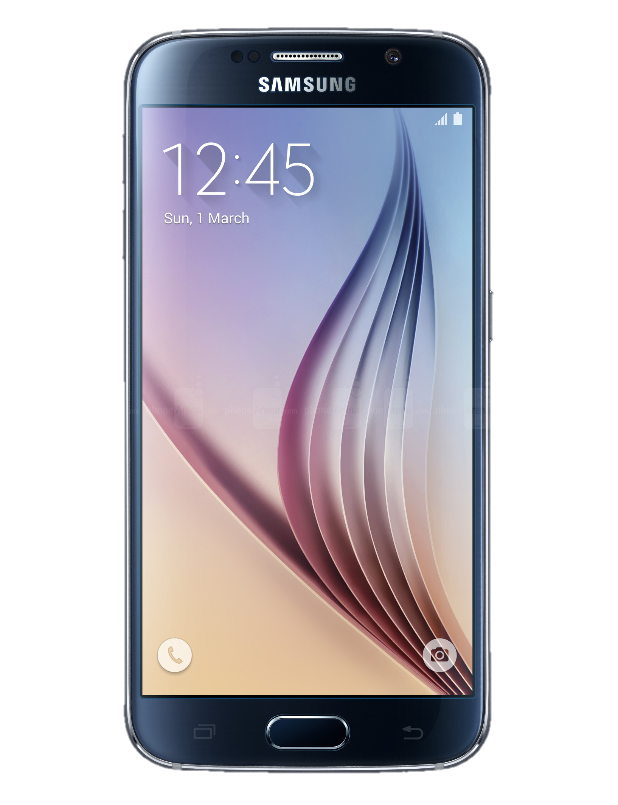
Hardware Tools
Android Phone
Minimum Requirements
Components | Detail
CPU | 1.2 GHz
Memory | 1GB RAM
OS | Android Kitkat
Connection | 3G Data
Storage | 8GB
Referensi :
http://i-cdn.phonearena.com/images/phones/51975-xlarge/Samsung-Galaxy-S6.jpg

Slide 21
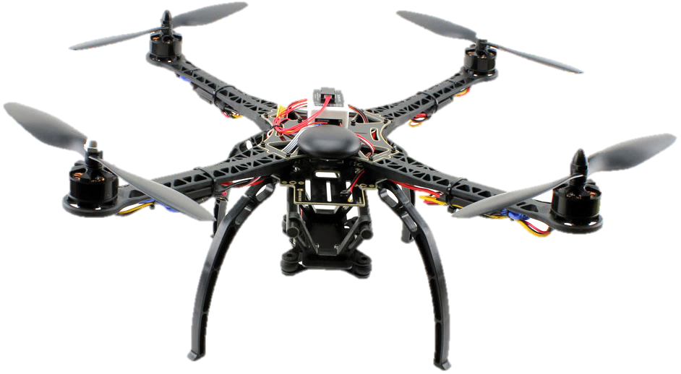
How it would probably looks!

Slide 22
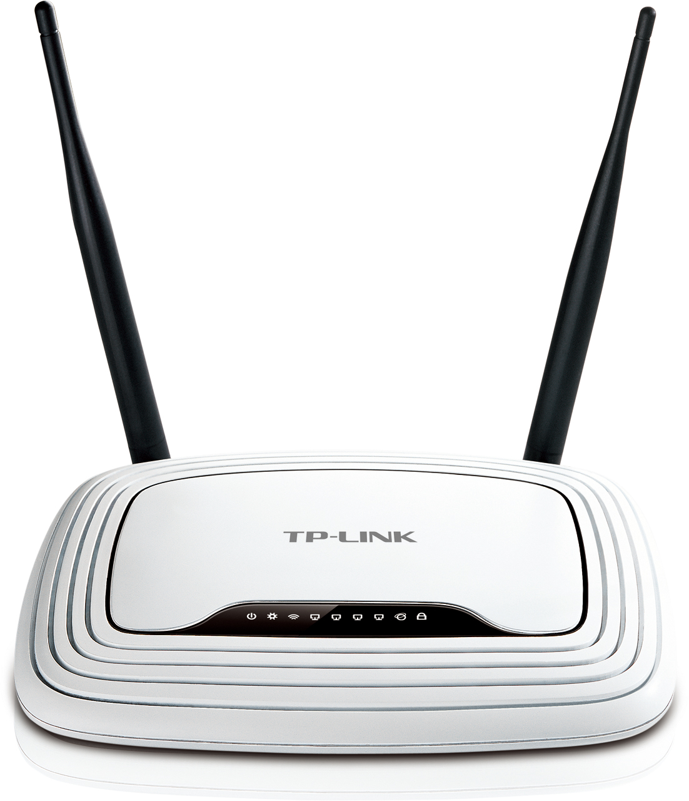
First Implementation
Short range control using 2.4GHz Radio
Command-line based, direct text instruction without voice recognition, Simple movement

Slide 23

Implementation
Communication through the Internet
Using Voice Recognition
Drone Video & Status feedback to android

Slide 24
Testing Risk/Assumption

Slide 25
Unit Testing
Item to Test | Test Description | Test Date | Responsibility
Android Application | The android application will be tested as of the performance and the design of the application to meet the acceptable user interface application | 25/11/2015 | Team
Drone | Drone needs to be able to do basic command such as ascending and descending, whereas the drone hardware integrity need to be maintain. | 25/11/2015 | Team
Data Communication | The connection between the application and the drone through the internet | 27/11/2015 | Team

Slide 26
Test Criteria
Test Pass / Fail Criteria
The system being tested pass if all the function will work as the requirements. If a failure occur than the test is said to be fail.
Test Entry / Exit Criteria
The beginning of the test will be with testing the application function to the drone. The test will stop after all function and commands is tested.
Test Deliverables
In the end of the testing the deliverables would be the test survey by user to improve the system, the report result of the test and the test analysis documents. The survey is necessary in order to evaluate through the user experience in using the application.

Slide 27
Test Criteria (Cont.)
Test Suspension / Resumption Criteria
The test will be suspend if an inevitable events shown such as a personal problems of the team members that he must attend or the weather condition that does not allow the project to be tested. In case such events occurred, the date of testing will be replace to an available date within week of the test.
Test Environmental / Staffing / Training Needs
In testing the project all staff does not need any training or skill to be able to conduct the test. The team only needs to know how to use an android applications by following the user guide.

Slide 28
User Testing Form Criteria
System Testing
System have to provide any information regarding response time and time delay.
Consistency and Standard
System have to use the standard naming and the system need to be consistent.
User Interface
The design have to be appealing and easy to use.

Slide 29
Testing Analysis

Slide 30

Application Logo

Slide 31
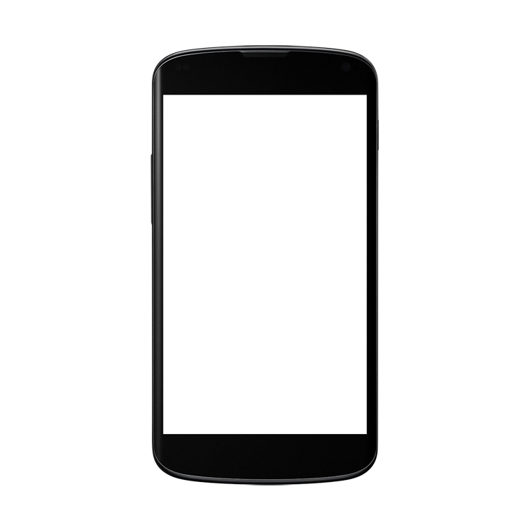
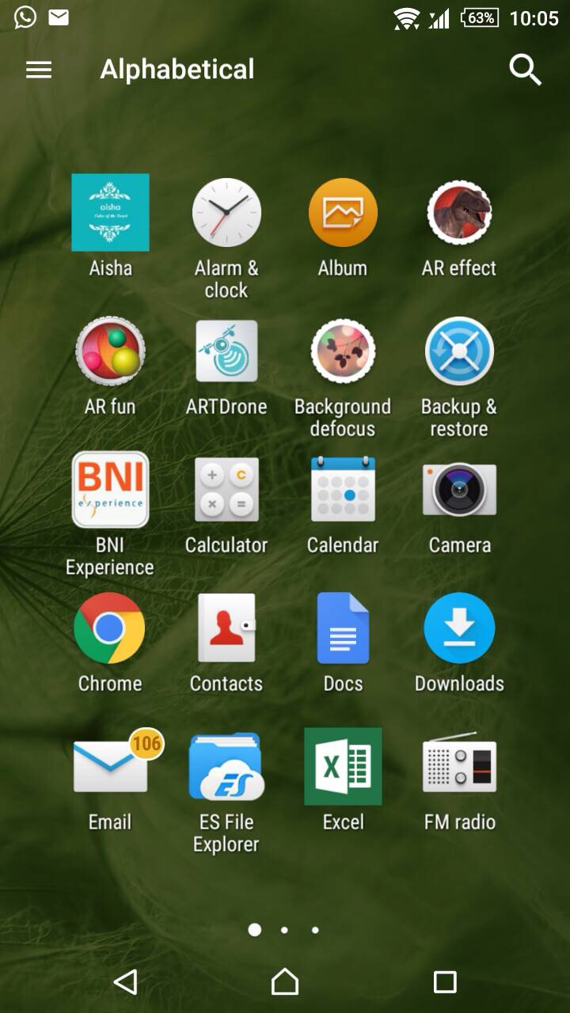
Screen

Slide 32
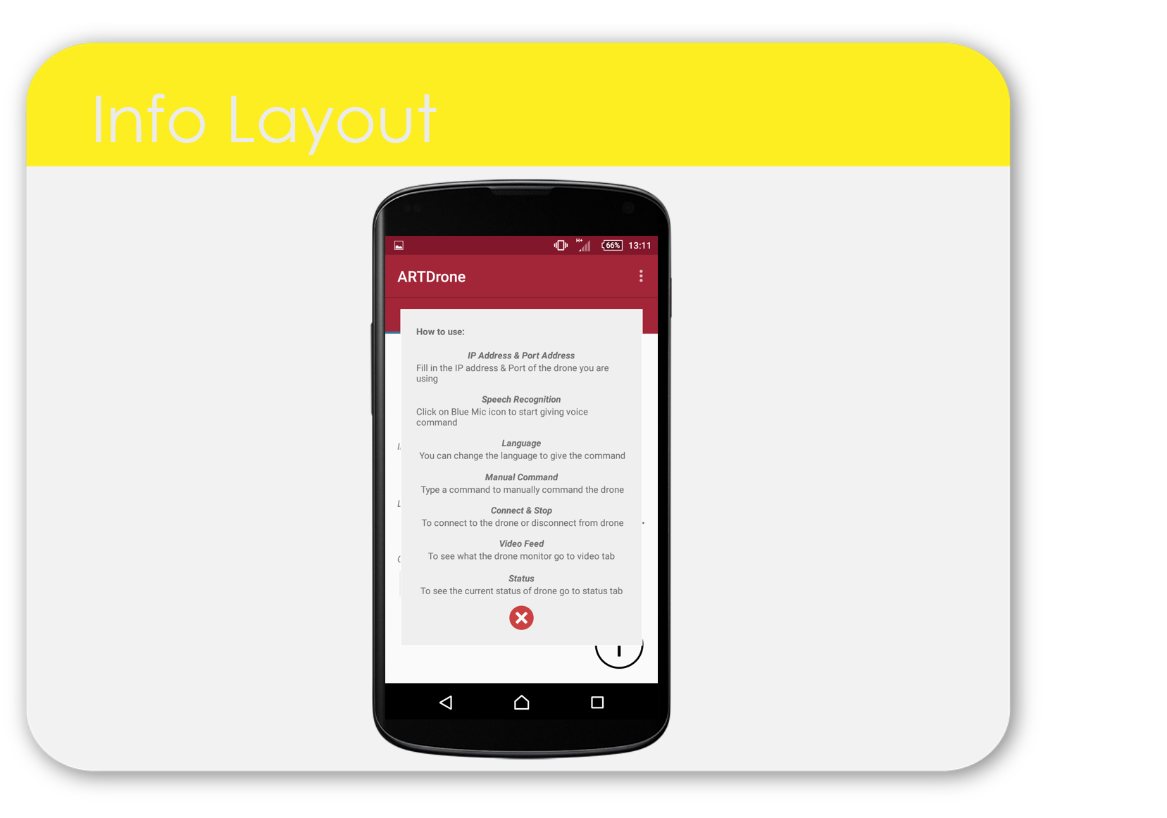
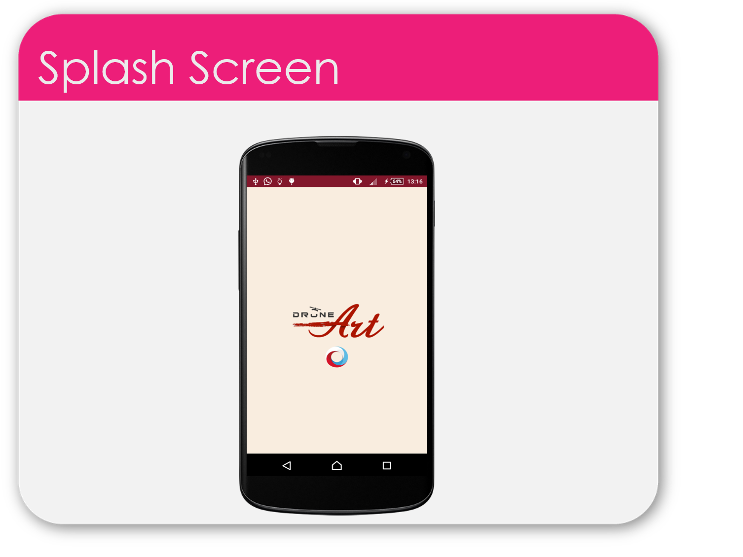
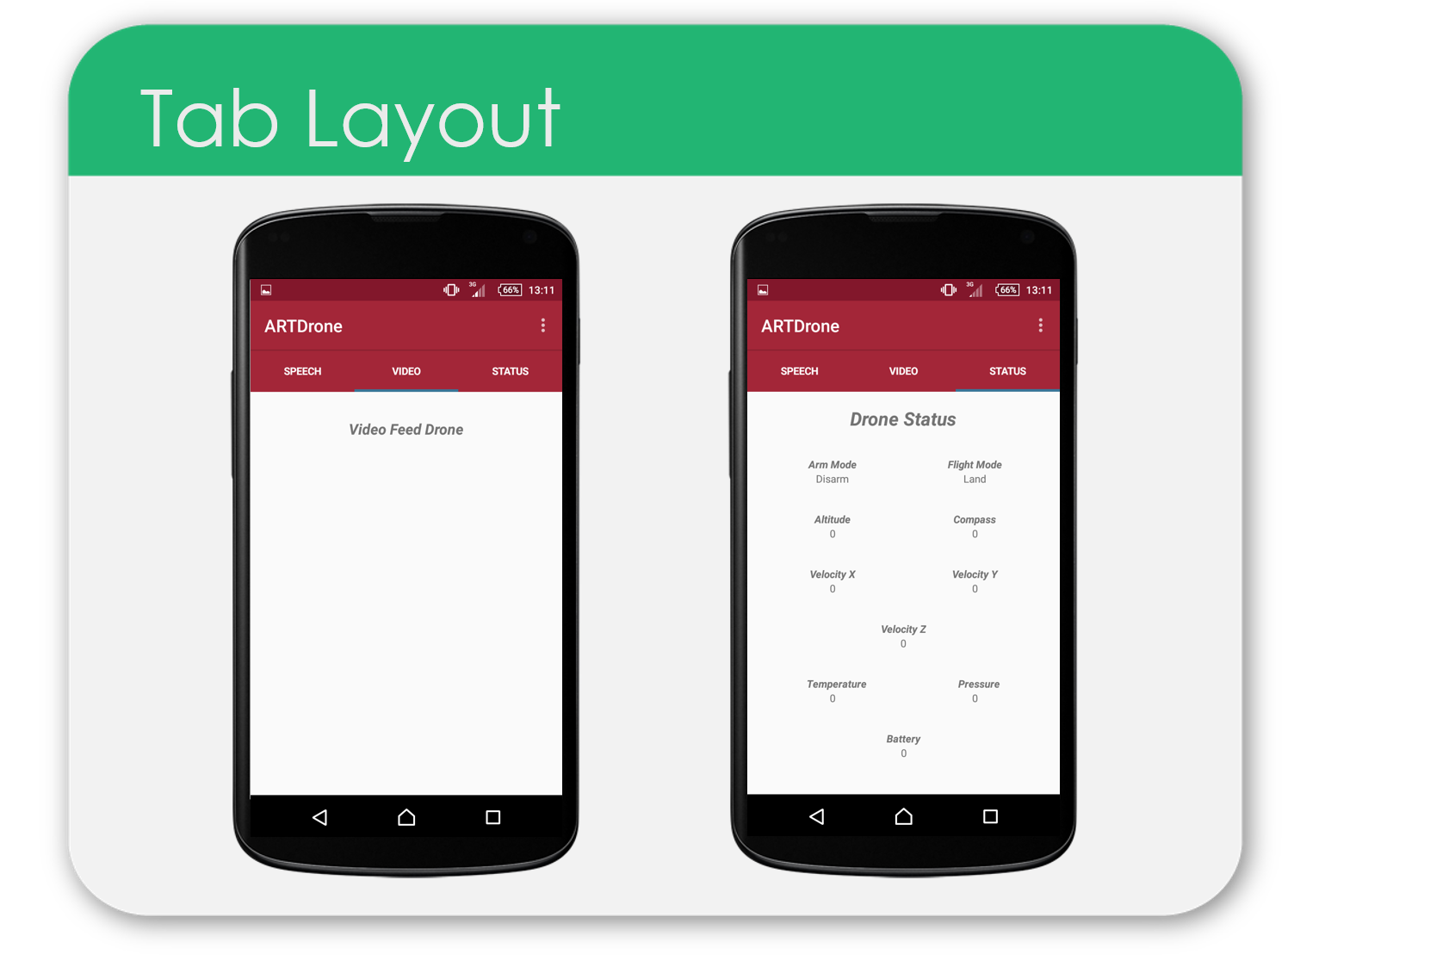
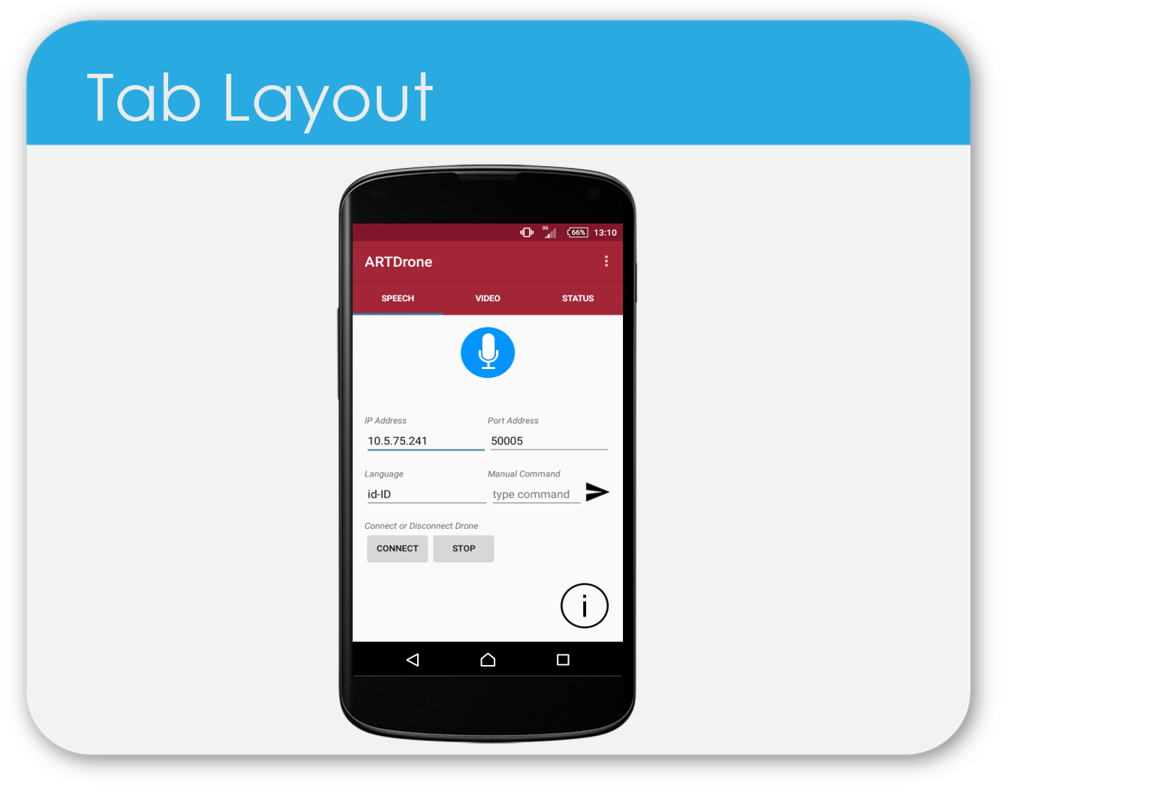
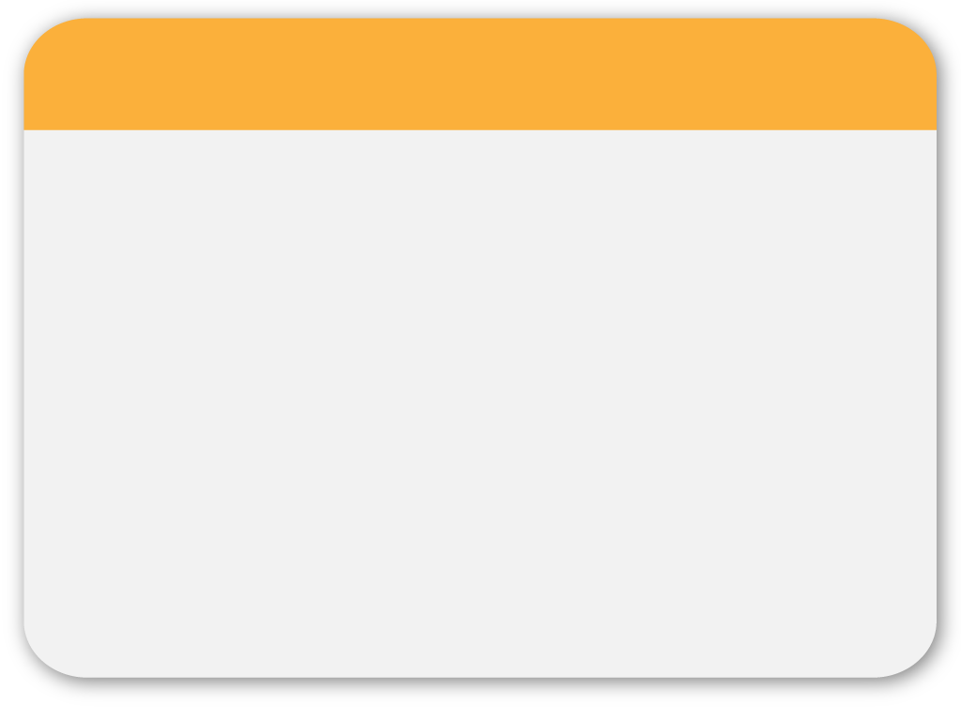
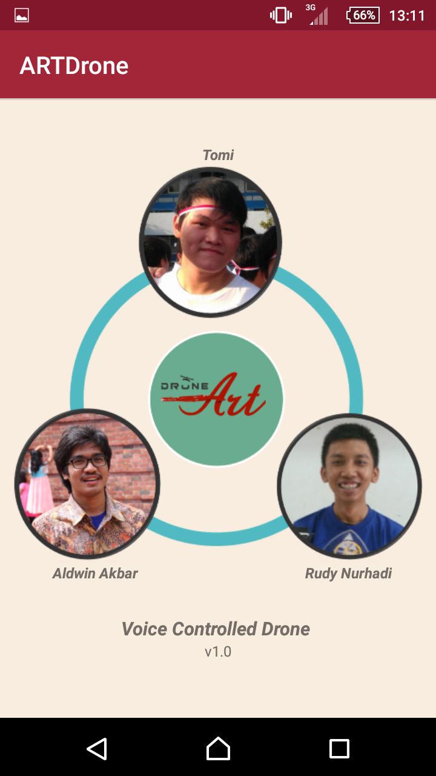
About Application

Slide 33
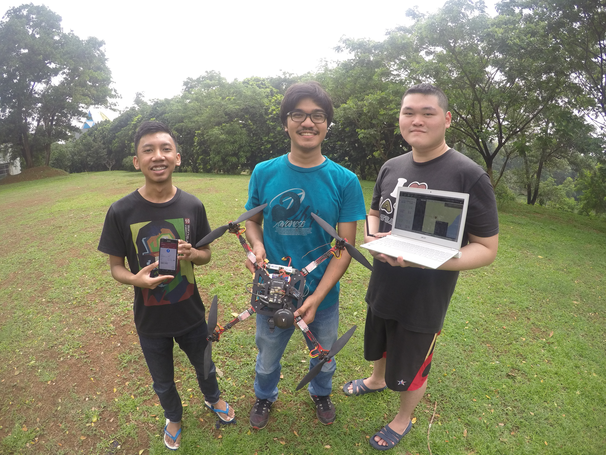

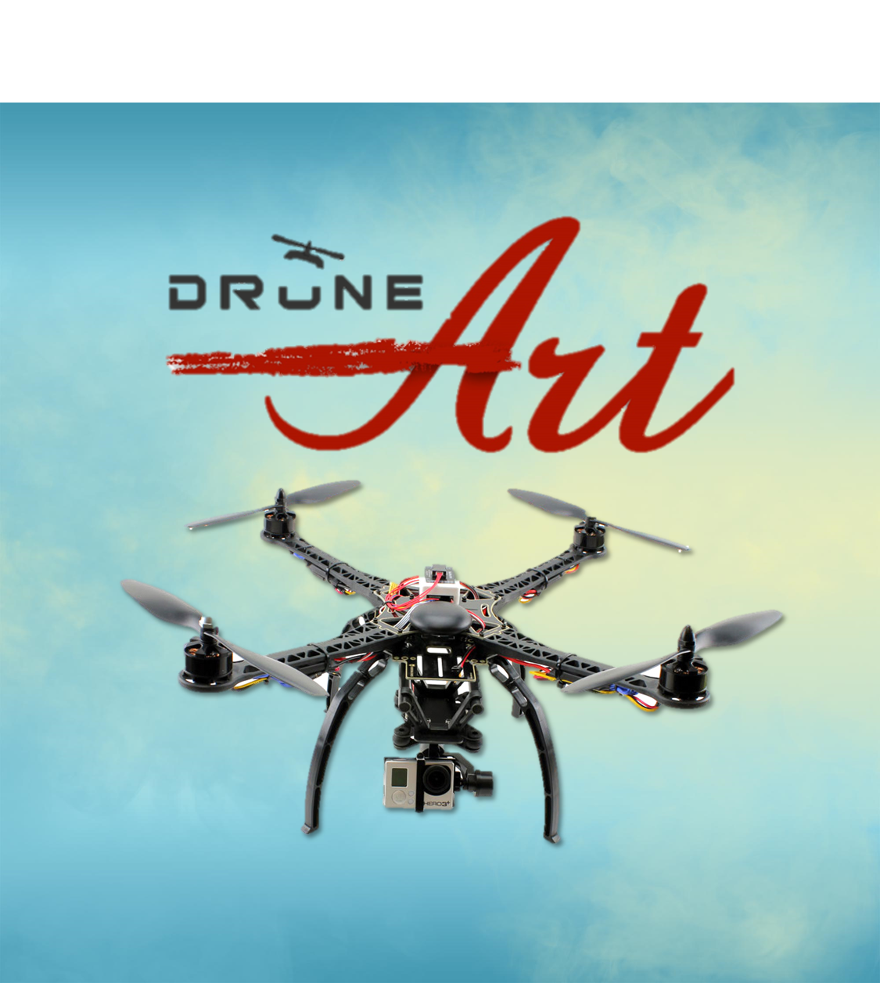

Slide 34


Slide 35
References
Spiral Model. http://www.princeton.edu/ accessed on 29th September 2013
The Eclipse Foundation open source community website. www.eclipse.org/ accessed periodically
Getting Started as Android Developer. developer.android.com/training/ accessed periodically
Android-related code. http://stackoverflow.com/ accessed periodically
Design Electronics. http://www.designelectronics.net/ accessed on 15th November 2013
Huda, Arif Akbarul. 24 Jam pintar pemrograman Android. 2012. Penerbit Andi : Yogyakarta.

